Slide 1
Augmented Reality-assisted Human Robot Interaction
Final Year Project Presentation
Monday 24th June 2019
Student:
Aufar P. Laksana
CID:
01093575
Project Supervisor:
Professor Yiannis Demiris
Second Marker:
Dr. Tae-Kyun Kim

Slide 2
Contents
Project Description
Motivation
High Level System Description
Breakdown of Systems
Testing
Evaluation
Future Work

Slide 3
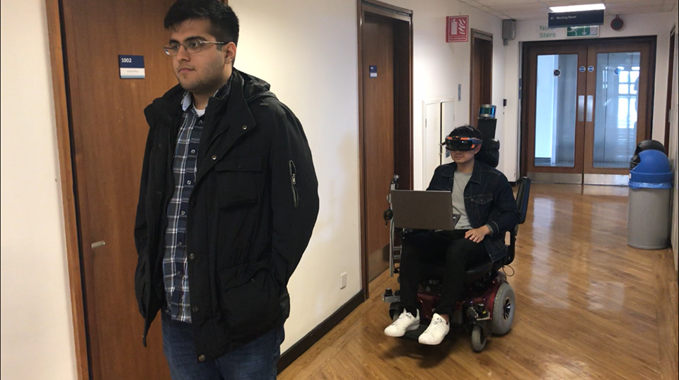
Project Description
Augmented Reality experience using the Microsoft Hololens.
Provides assistance to powered wheelchair users (PWUs) by:
Locating people in the surroundings.
Displaying holograms to PWU.
Reactive control system to prevent collisions with people when operating wheelchair manually.
1
Notes:
This project involved developing an augmented reality system using the Microsoft Hololens that assists powered wheelchair users in navigating around people in crowded areas.
We utilize the Hololens as a visual input to detect and determine the positions of people in the surroundings
Using these positions, we can then use the augmented reality capabilities of the Hololens to display information to the powered wheelchair user, such as their position and the direction they are walking in relative to the PWU
We also use the knowledge of their positions to provide a simple reactive control system that prevents collisions during manual control of the wheelchair, by manipulating the speed of the device.

Slide 4
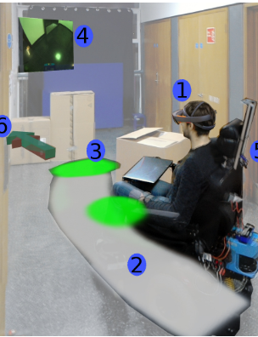
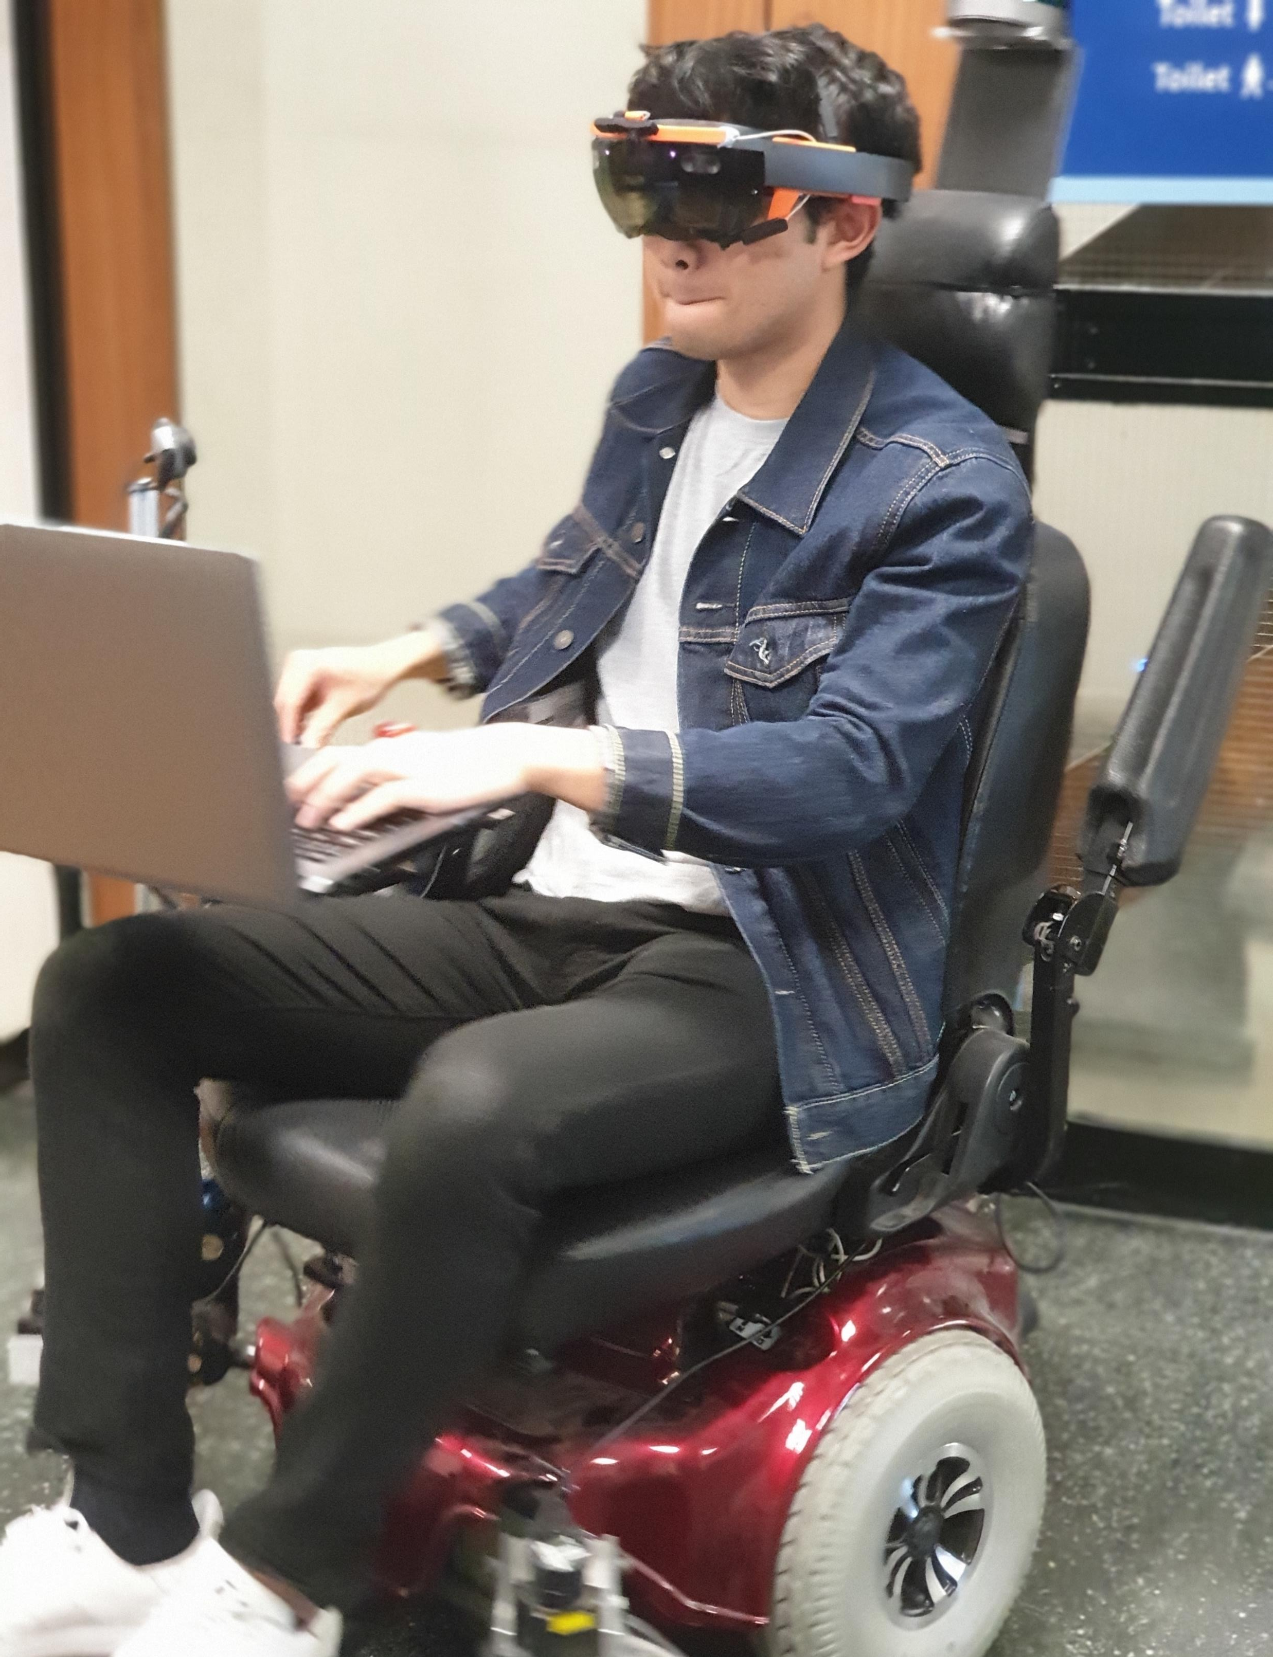
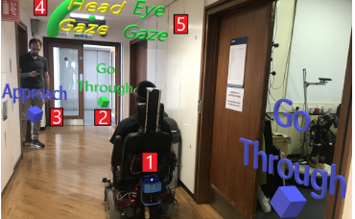
Motivation
PRL Research Inspiration:
Head-Mounted Augmented Reality for Explainable Robotic Wheelchair Assistance.
Augmented Reality Control of Smart Wheelchair Using Eye-Gaze-Enabled Selection of Affordances.
“Power wheelchair users (PWUs) report being afraid to navigate in crowded spaces with their device” [3]
Personal Interests
Mobile Robotics.
Self Driving Cars/Drones.
Not really interested in Humanoid Robots.
[1] M. Zolotas, J. Elsdon, and Y. Demiris. Head-mounted augmented reality for explainable robotic wheelchair assistance
[2] Rodrigo Chac´on-Quesada and Yiannis Demiris. Augmented Reality Control of Smart Wheelchair Using Eye-Gaze-Enabled Selection of Affordances
[3] Kairy, D., Rushton, P. W., (2014). Exploring powered wheelchair users and their caregivers’ perspectives on potential intelligent power wheelchair use: A qualitative study.
Notes:
In the PRL, a few of the PhD students have used the Hololens and smart wheelchair ARTA in their research
Mark: displaying the internal states such as the planned path of the assistive control
Rodrigo: using the Hololens to provide an interface to the user for controlling the wheelchair, such as recognizing the positions of doors and giving the user the option to go through the door using eye tracking

Slide 5
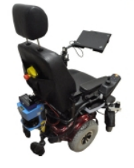
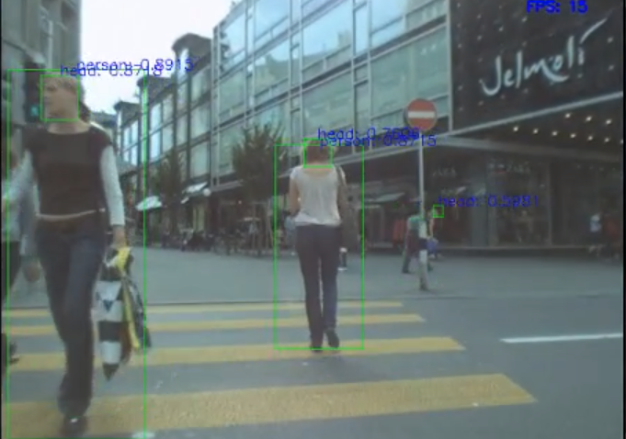
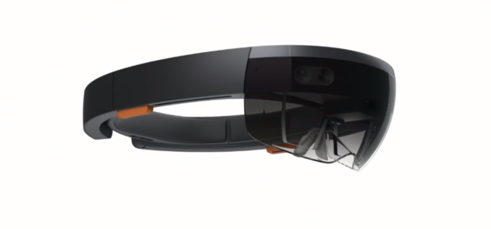
High-level System Description
Notes:
Project is split into 3 separate systems, one on running on each device:
Hololens
Captures the view the PWU has using front facing camera
Maps the detected people in the surroundings
Creates hologram visualizations
HDD (Human Detection & Direction)
Runs on a partner computer, receives frames from Hololens
Processes frames by detecting people and direction relative to PWU
Streams detections back to the Hololens
ARTA (Assistive Robotic Transport for Adults)
PRL smart powered wheelchair
PWU controls the wheelchair using joystick
Receives control signals from Hololens to avoid collisions

Slide 6
Node View
Notes:
ROS ROS ROS ROS ROS
Since this project spans across several devices, we needed a way of communication between programs running on different devices.
We use the Robotic Operating System (ROS) as a means of communication.
The beauty of using ROS is that we can run a program (node) on the Hololens, and stream data to other nodes
The nodes receiving the data on the processing PC doesn’t know the data came from another computer, all it cares is that it received an image it can process.

Slide 7
Holo: Hololens
Notes:
Here is the unit application, we can break it into two parts. It runs on the Microsoft Hololens.
We want to see what the user sees, so we need access to the front facing camera that captures the users view
And stream it over the network.

Slide 8
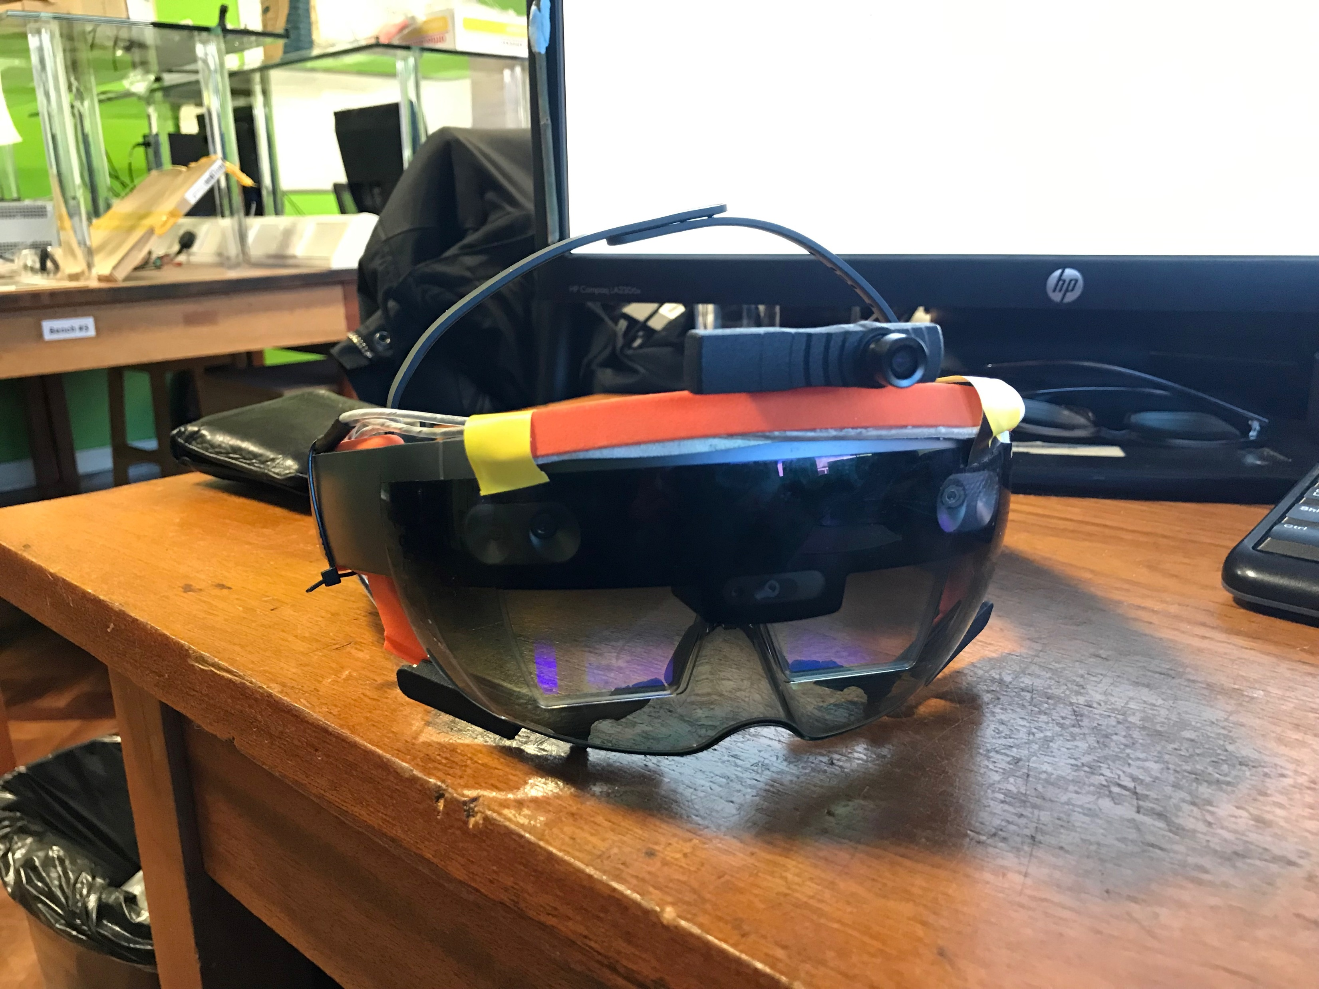
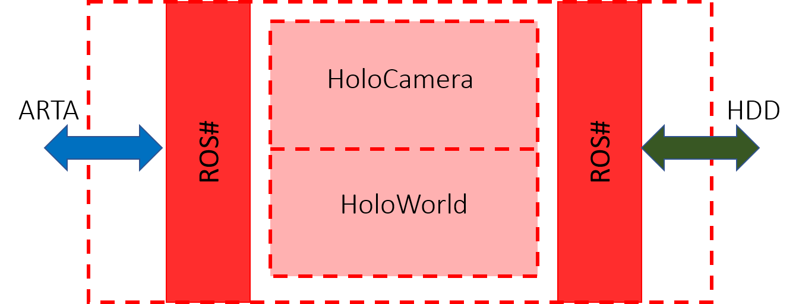
Holo: Camera Stream
Compared alternatives:
Windows Device Portal – Latency of 2-3 seconds.
HololensForCV, Microsoft Computer Vision library
Designed to run on Windows using C#, standalone UWP application
Raw sensor data streams.
Difficulty in converting network streams between UWP and Linux.
Hololens runs the Unity Game Engine on UWP.
Large community support for Mixed Reality and Hololens.
Mixed Reality ToolKit (MRTK).
Abstracts away a lot of the complicated sensor data handling.
No need to work with raw depth values from depth camera.
Communication handled by ROS#
Uses ROS messaging protocols of subscribers and publishers.
Can communicate with other ROS nodes seamlessly.
Notes:
# CLICK, point out camera
We developed a way of accessing the front facing camera of the device and streaming it over the network
Had to compare a few alternatives, however we ended up going with Unity
Abstracts away raw sensor data handling
Ability to use ROS# to communicate with other ROS nodes.

Slide 9
Node View
Notes:
We now go on to the partner PC and explain the system running there.

Slide 10
HDD: Human Detection & Direction
Notes:
Partner PC has a GTX 1050Ti GPU
Receives captured frames from Hololens
Detects people, predicts bounding boxes
Bounding boxes are passed on
Assign a tracking identity
Determine if the person is facing towards/away from the PWU
Results are streamed over the network back to the Hololens

Slide 11
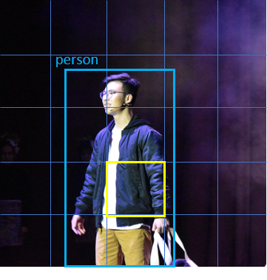
HDD: Object Detector - YOLO
You Only Look Once (YOLO) Object Detector [4]
Exhaustively searches an image and predicts bounding box and class for each grid cell.
Runs on Darknet NN framework.
We use the Robotic Operating System (ROS) as a means of communication between devices.
Had to port Darknet into ROS as a package to receive camera frames from Hololens.
Writing Python wrappers around Darknet C code for ROS integration.
Trained YOLOv3-Tiny on a pedestrian detection dataset.
CrowdHuman Dataset [5]
Unique identities, large diversity in images.
Bounding boxes labelled with partial occlusion.
[4] Joseph Redmon, Santosh Kumar Divvala, Ross B. Girshick, and Ali Farhadi. You only look once: Unified, real-time object detection.
[5] Shuai Shao, Zijian Zhao, Boxun Li, Tete Xiao, Gang Yu, Xiangyu Zhang, and Jian Sun. Crowdhuman: A benchmark for detecting human in a crowd.
Notes:
YOLO object detector
Darknet framework
Had to integrate the framework into ROS so we could receive messages from other nodes
Achieved this by wrapping the core C library in Python wrappers so it could communicate as a ROS node
Also trained the network using a pedestrian dataset
Wanted to improve detections of people

Slide 12
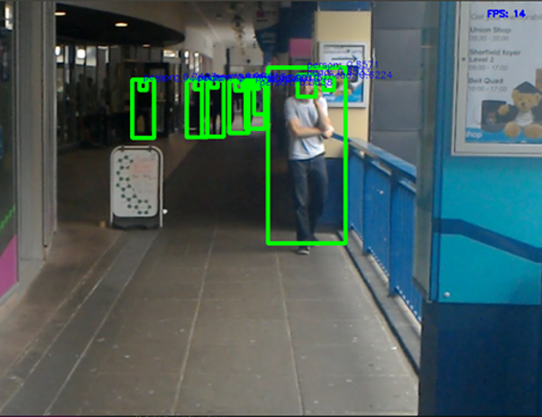
HDD: Object Detector - YOLO
Recorded test videos using Hololens around Imperial College Campus.
Videos were recorded while moving.
Improvements:
Better detection of people
At range
Occlusions
Head detection
Direction prediction using head pose estimation.
Notes:
Recorded a few test videos around campus
With original pre-trained network on the COCO dataset, we were unable to detect the people in the background.
With the trained network, we noticed
Better detection at range
Better detection of partially occluded/obscured people

Slide 13
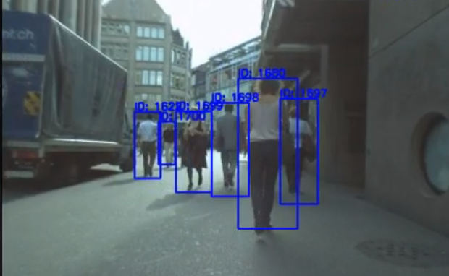
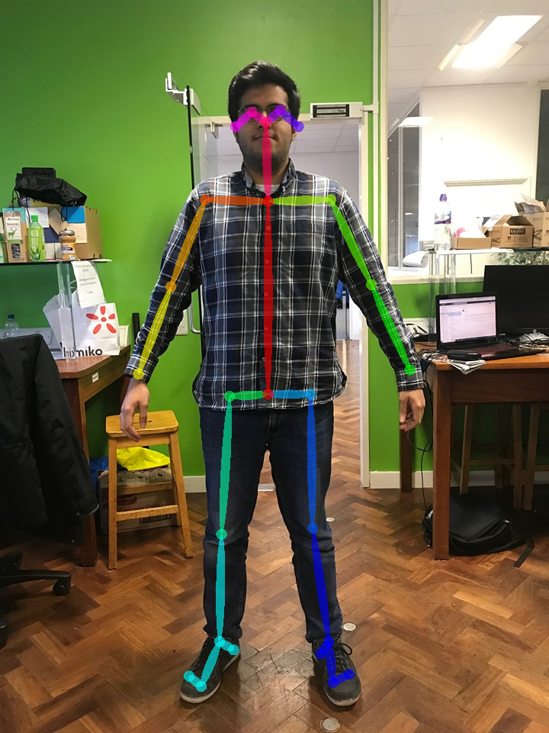
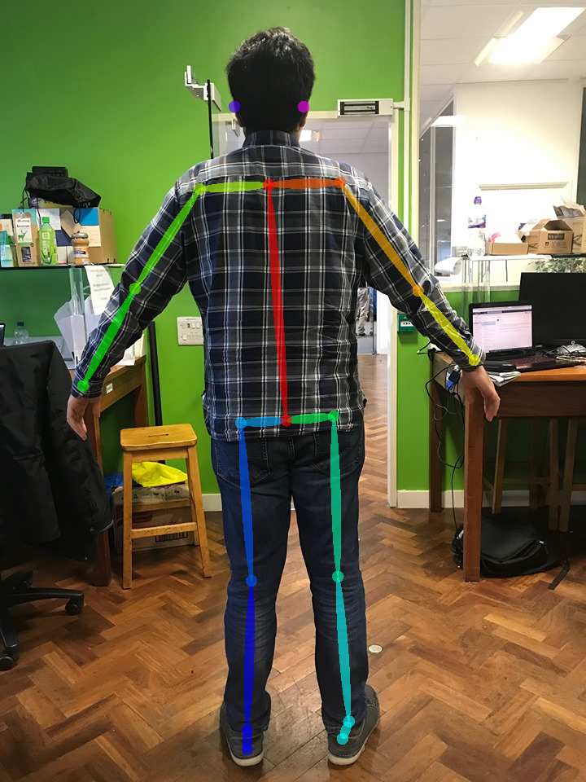
HDD: YACHT Tracking & Direction
Developed the Yet Another CrowdHuman Tracker (YACHT) ROS Package.
The ROS nodes consume bounding box detections from YOLO object detector node.
Deep SORT [6]
Real time object tracking using deep descript vectors.
OpenPose Body Pose Estimation [7]
Used to determine if a person is walking towards/away from the camera.
Tracking ID / Direction + Bounding Box streamed over network to Hololens
[6] N. Wojke, A. Bewley, and D. Paulus. Simple online and realtime tracking with a deep association metric.
[7] Zhe Cao, Gines Hidalgo, Tomas Simon, Shih-En Wei, and Yaser Sheikh. Open- pose: Realtime multi-person 2d pose estimation using part affinity fields
Notes:
We then developed our own ROS package called YACTH
This includes an object tracker that can track the bounding boxes across frames.
As well as the cooler part, the body pose estimator
What the OpenPose network does is it estimates a skeleton of keypoints on people in an image
We can use the positions of the keypoints to discern between limbs, and as such, we can tell which direction a person is facing.

Slide 14
Node View

Slide 15
Holo: Hololens

Slide 16
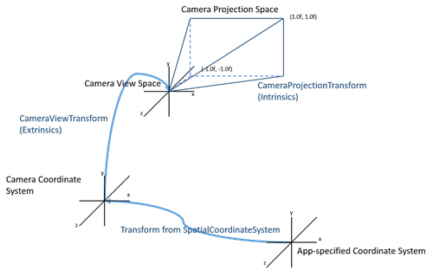
Holo: Matching & World Placement
IOU Matching of Bounding Boxes to match Tracker ID & Direction messages.
Possible latency between messages.
Unity GameObject created for each detected person.
We can think of the GameObject as the representation of the person in the MR World.
Need to correctly place GameObject relative to Hololens.
Convert a 2D image coordinate to a 3D world coordinate.
Difficult to tell distance to object since we lose the z-axis when we capture the frame.
Best we can do is to pass a ‘ray’ through the image point.
Object can exist anywhere along that ray in the real world.
Un-project 2D point to Camera Frame, translate to World Frame.
Notes:
Using our captured image and detections, we build up a Virtual Map of the world surrounding the Hololens.
This is done by unprojecting a 2D image coordinate into a 3D world coordinate.
However, when we first capture an image, we lose one axis of information, the distance to an object, since we are projecting from a 3D space to a 2D space.
The best thing we can do is to project a ray through the 2D point in the image
This means the object can exist anywhere along that ray.

Slide 17
Holo: Matching & World Placement
Un-project 2D image coordinate to 3D world coordinate.
Hololens function pix2World().
Not the most accurate placement of GameObject.
Hololens Spatial Mapping
Continuously mapping the surroundings.
Detecting surfaces and the distance between Hololens and surfaces.
Depth Cameras on Hololens.
Hololens Ray Casting
Can “shoot” a ray of light from the Hololens through a point in 3D space.
Shoot ray through the initial placement of the GameObject.
Spatial Mapping will detect a person behind the point, Ray hits person.
GameObject world coordinate corrected to the point at which ray hits person.
Notes:
This is why we use the Hololens
The hololens is continuously mapping the surroundings using spatial mapping
Done using the depth cameras on the device
Essentially, it detects surfaces in the surroundings, and can calculate the distance to the surface.
What we do is we use spatial mapping to shoot a ray from the Hololens through a 3D world position
When the ray hits a surface, which should be the detected person, the 3D world co-ordinate is corrected to the point it hits the person.

Slide 18
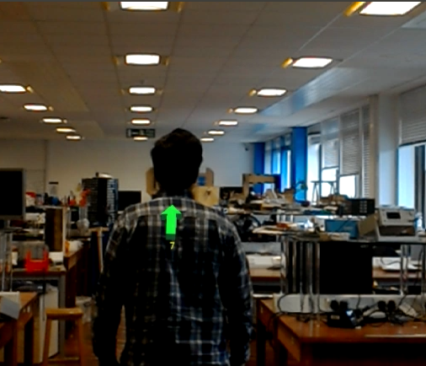
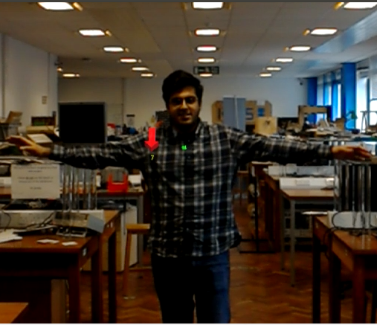
Holo: Hologram Visualizations

Slide 19
Holo: Hologram Visualizations

Slide 20
Node View

Slide 21
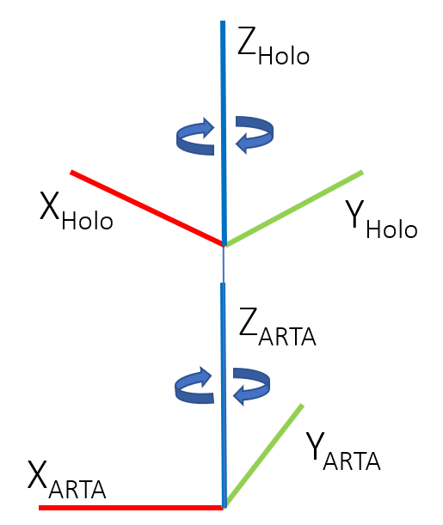
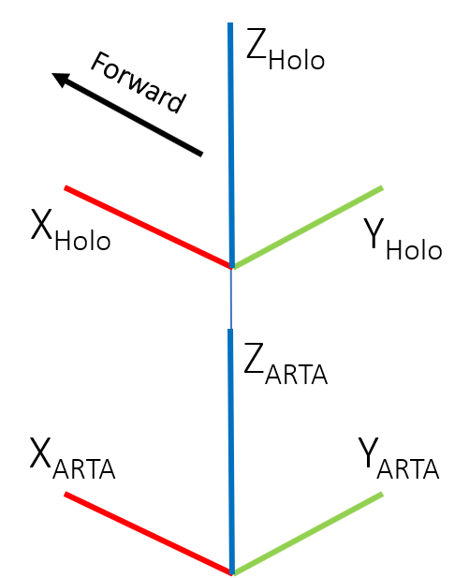
ARTA: Alignment
Need to align frames of ARTA and Hololens
Reactive Control only runs when the detected person is in the trajectory of wheelchair.
If PWU is looking to the side, not an immediate collision risk.
Simplified frame transform so that PWU can only rotate about z-axis between -90 and +90 degrees.
PWU can not rotate their head a full 360 degree.
Calibration upon startup of Unity application and ARTA.
Compare Hololens Rotation and ARTA Rotation Pose.

Slide 22
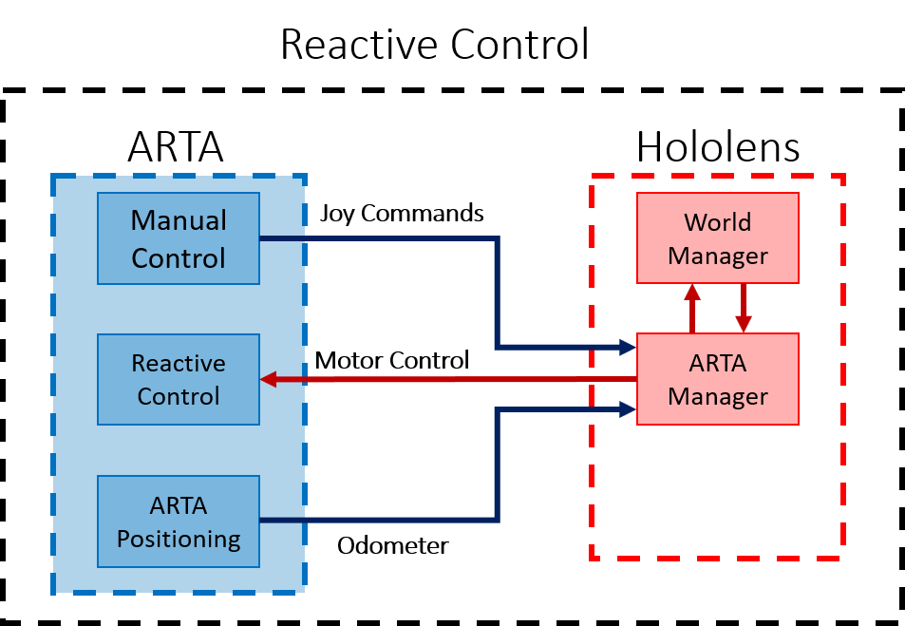
ARTA: Reactive Control
Subscribes to joystick inputs on ARTA from PWU.
Monitors the direction and speed ARTA is going in.
If a detection is in the forward trajectory of wheelchair, takes over control.
Slows down the wheelchair depending on distance to detected person.
Depends on direction of person.
Slows down faster if person is walking towards wheelchair.
If directly in front, wheelchair remains still even if PWU wants to move forward.
Notes:
The wheelchair responds to the joysticks commands.
Under the constraint of maintaining a safe distance between the PWU and people.
There is the added intricacy that the constraint is stricter when someone is walking towards the PWU.

Slide 23
Testing
Three Controlled Scenarios
Person walking towards wheelchair.
Person walking away from wheelchair.
Person to the side, out of wheelchair trajectory.

Slide 24
Evaluation
Limitations
JPEG Compression limits frame rate of AR application
Unity Engine single threaded for image compression.
Lose detections when object is very close to the camera.
Should not rely on a single source of object detection
Didn’t use all sensors available to us.
ARTA has its own localization and object detection capabilities, could have fused spatial mapping detections with laser scanner mapping.
During original testing, reactive control slow down was too aggressive and fast.
We have since altered it to be smoother.
Achievements
Developed ROS Packages for YOLO, DeepSORT that can be reused.
Developed Video stream of front facing camera from Unity at acceptable frame rate.
Reactive control system can prevent collisions as shown in controlled tests.
Holographic visualizations to help PWUs notice potential collisions.
Notes:
Due to image compression limitations in Unity, the augmented reality experience has a limited frame rate.
We hoped to do tracking without the use of the depth camera
This proved to be too difficult for the scope of this project.
This project is not about making a more efficient system for obstacle avoidance.
It is about showing that these systems can be implemented on portable augmented reality devices such as the Hololens.
In the future, we expect AR devices to be more prevalent

Slide 25
Conclusion
Developed an augmented reality experience for PWU users navigating in public spaces
Detects people in surroundings and determines direction.
Displays holograms to user indicating direction and potential collisions.
Reactive control system prevents collisions by controlling the velocity of powered wheelchair.
Limited by:
Image/Video compression in Unity on Hololens.
Single sensor stream of data (front facing camera).
Spatial Mapping does not work 100% of the time on moving objects.
Questions?

